Slide 1
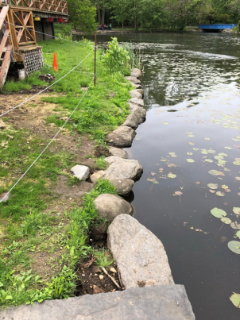
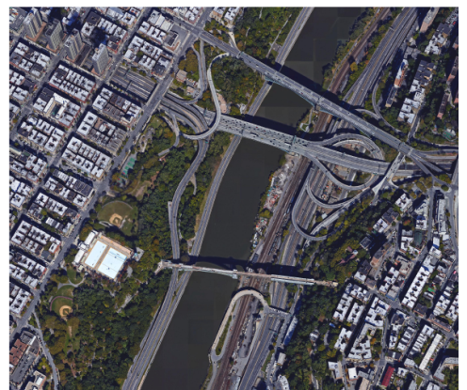
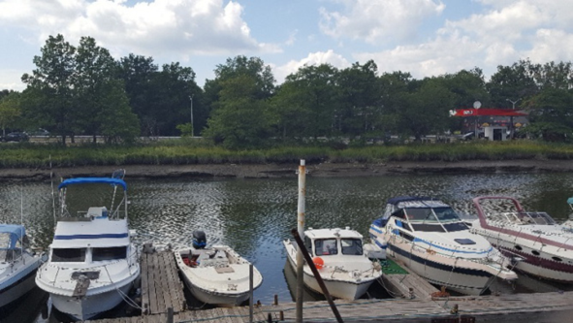
Bronx Living Shoreline The Lake at Van Cortlandt Park, Depot Place (aka Bridge Park South) at Harlem River and Hutchinson Parkway at Westchester Creek
Bronx Council for Environmental Quality with the
Gaia Institute and Dland Studio
At the Bronx Parks Department
Meeting # 2
October 15, 2018

Slide 2
Agenda
Introductions
Why we are here? What is our goal?
Consultant presentation of conceptual design and/or other ideas
Response from Parks

Slide 3
Prepare a guide to Low Impact Development (LID) practices to preserve and protect our water, air and land. Using green infrastructure (GI) for stormwater treatment strategies for developing and/or retrofitting natural resources near the waterfront is less invasive and expensive than traditional concrete uses.
Living shoreline is a broad term that encompasses a range of shoreline stabilization techniques along estuarine coasts, bays, sheltered coastlines, and tributaries. A living shoreline has a footprint that is made up mostly of native material. It incorporates vegetation or other living, natural “soft” elements alone or in combination with some type of harder shoreline structure (e.g. oyster reefs or rock sills) for added stability. Living shorelines maintain continuity of the natural land–water interface and reduce erosion while providing habitat value and enhancing coastal resilience.
~Guidance for Considering the Use of Living Shorelines, 2015, NOAA, page 7
https://www.habitatblueprint.noaa.gov/wp-content/uploads/2018/01/NOAA-Guidance-for-Considering-the-Use-of-Living-Shorelines_2015.pdf
Create one-page two-sided handout for advocates to educate agency and elected officials. Different handouts for each site or sites should include site and sketch and be 1/3 the handout. Concepts and Talking Points should be 1/3 each

Slide 4
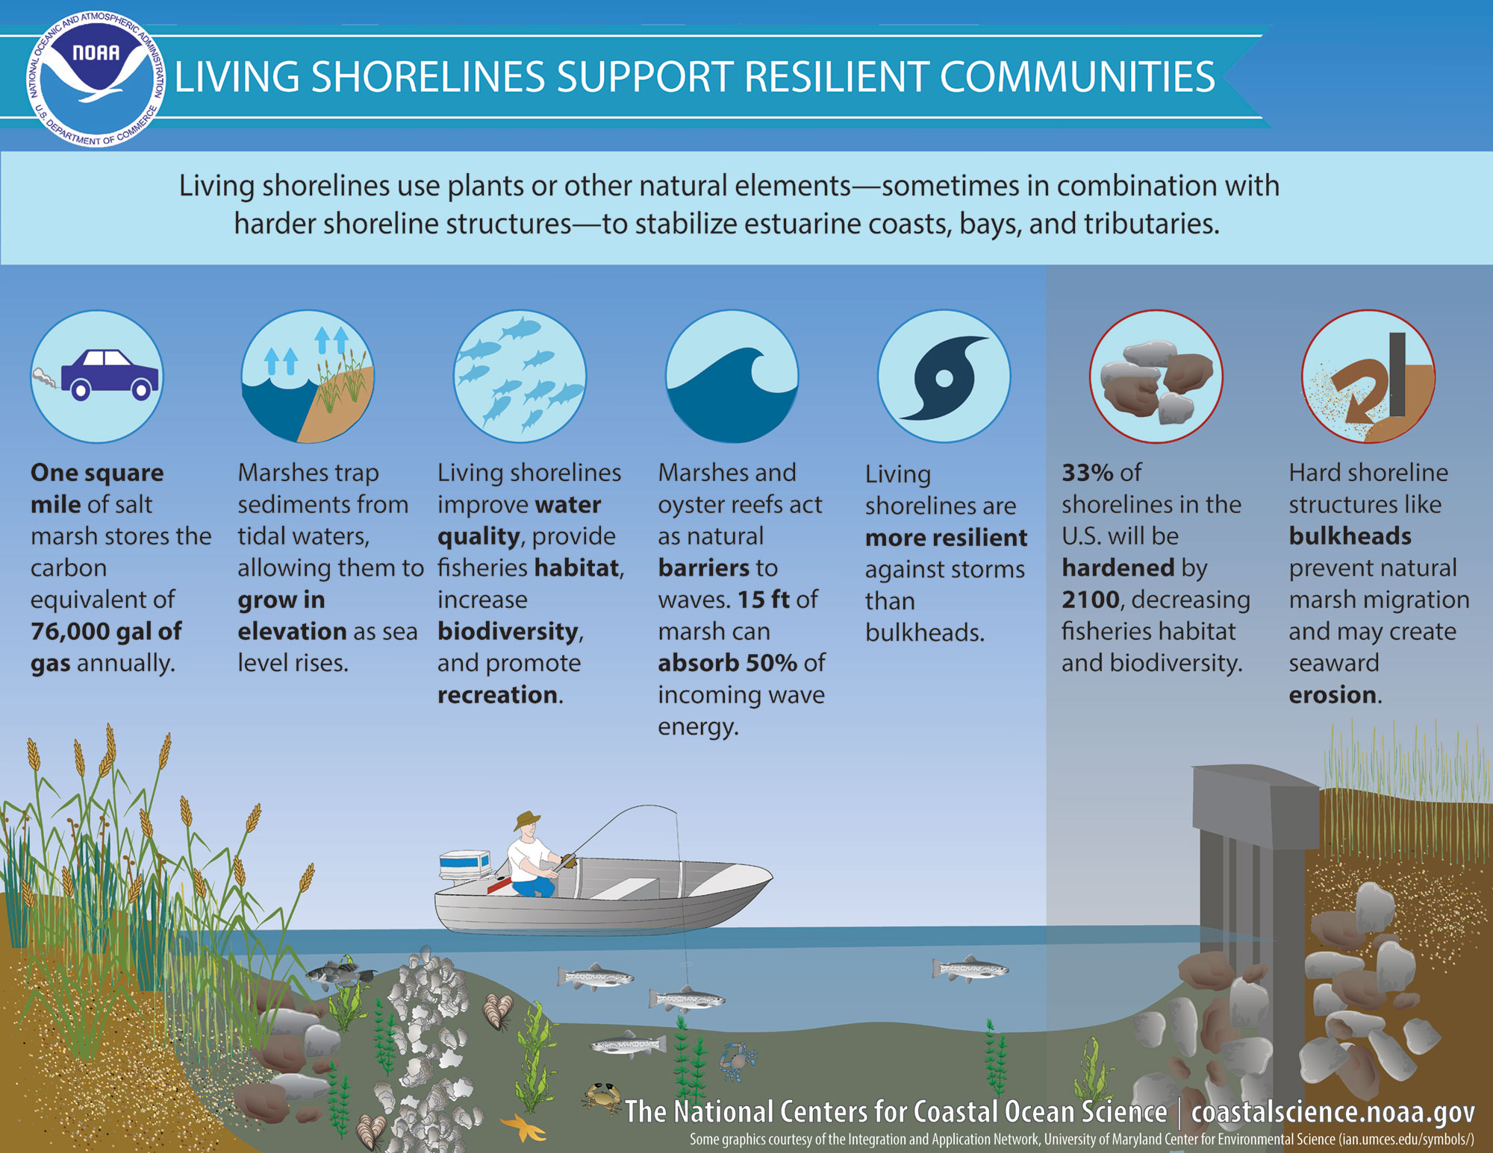

Slide 5
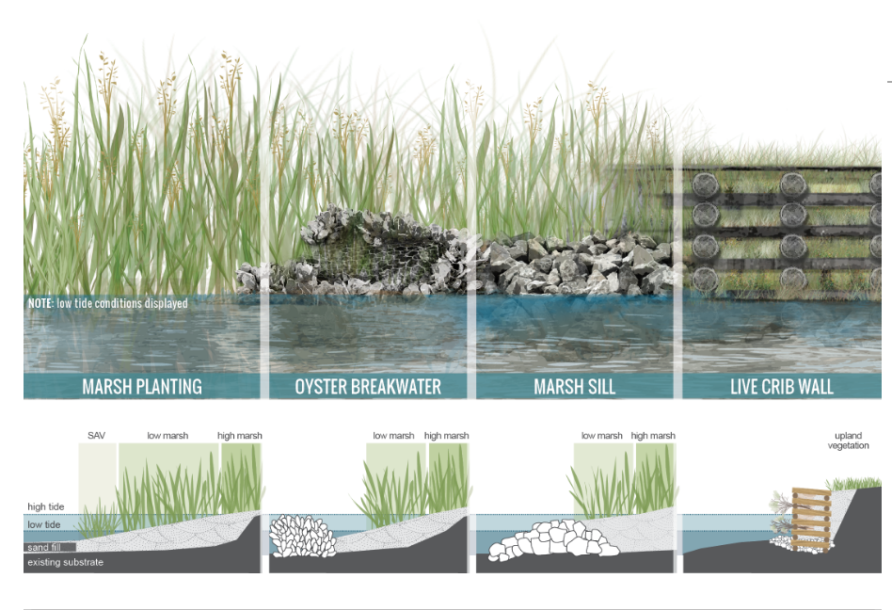

Slide 7
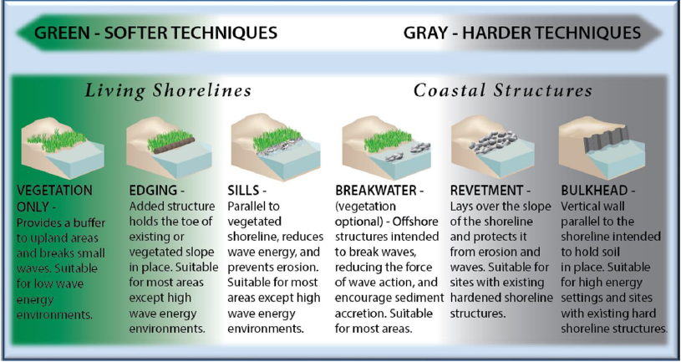

Slide 9
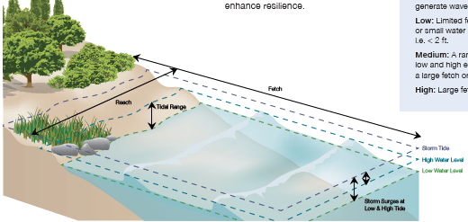

Slide 10
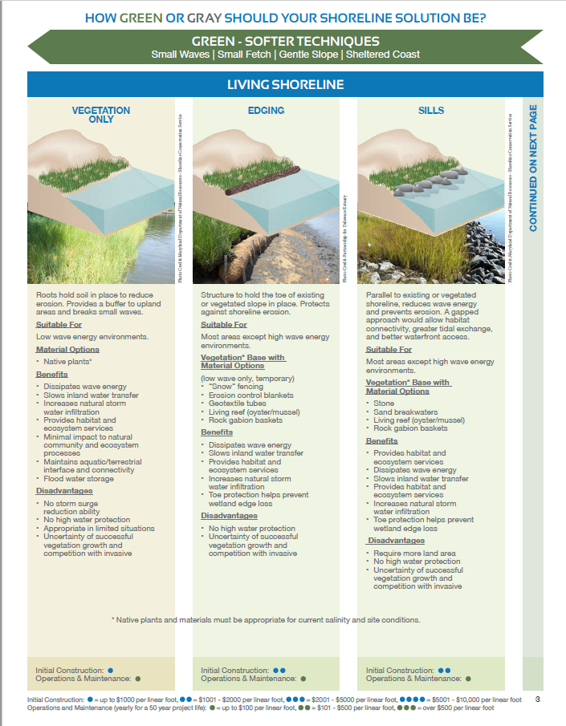
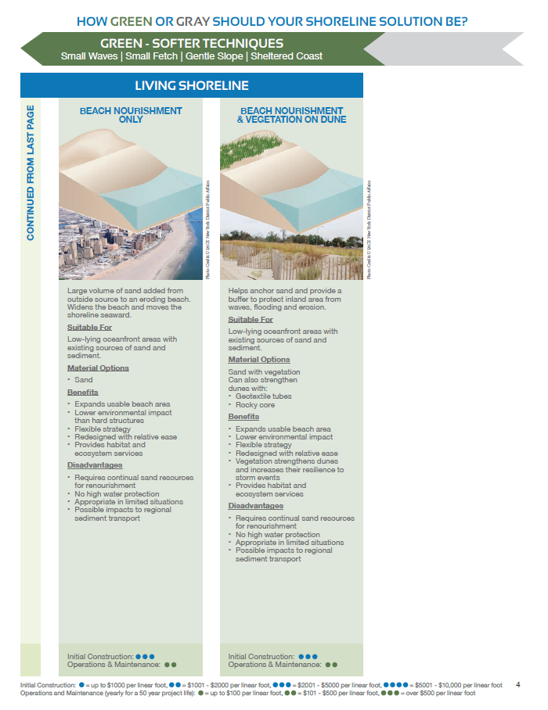

Slide 11
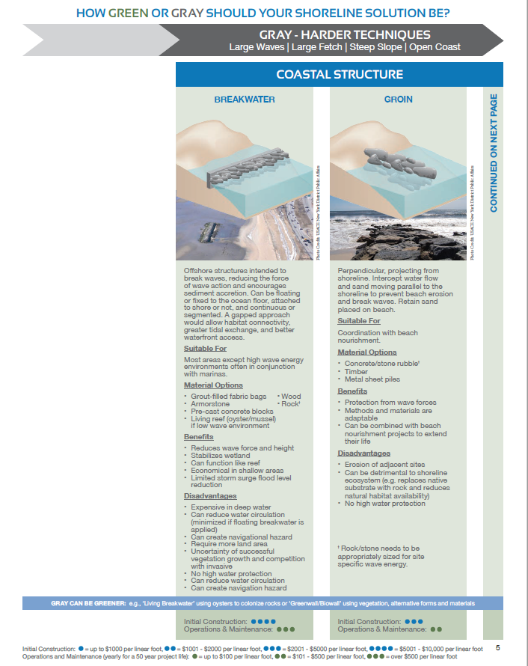
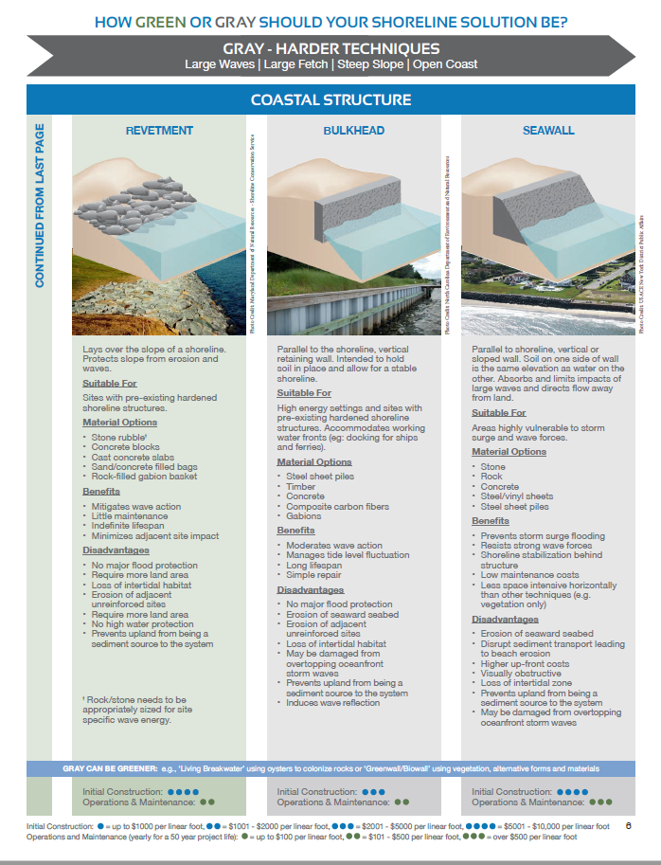

Slide 12
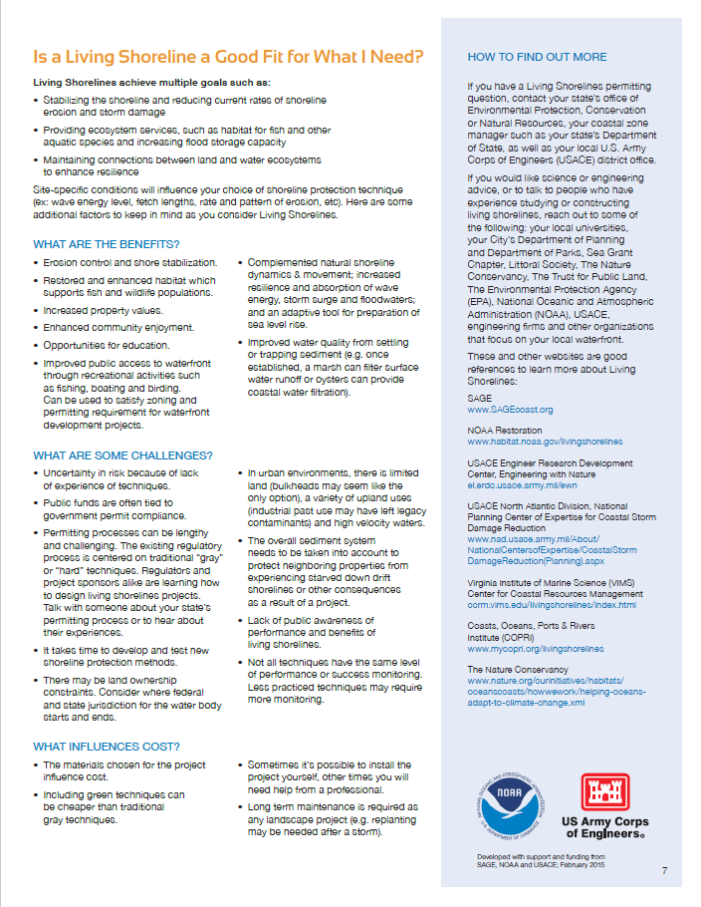

Slide 13
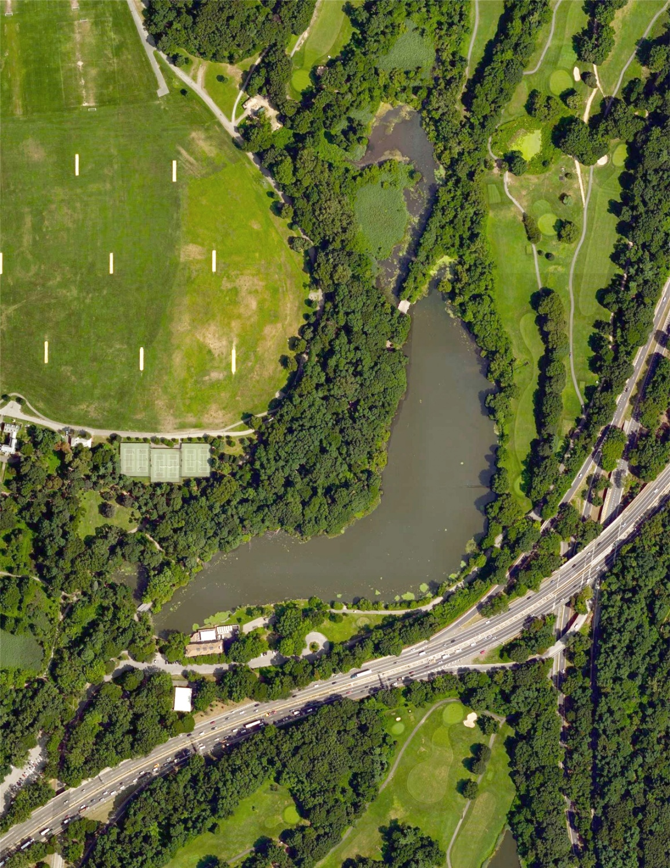
Site 1: Van Cortlandt Lake

Slide 14
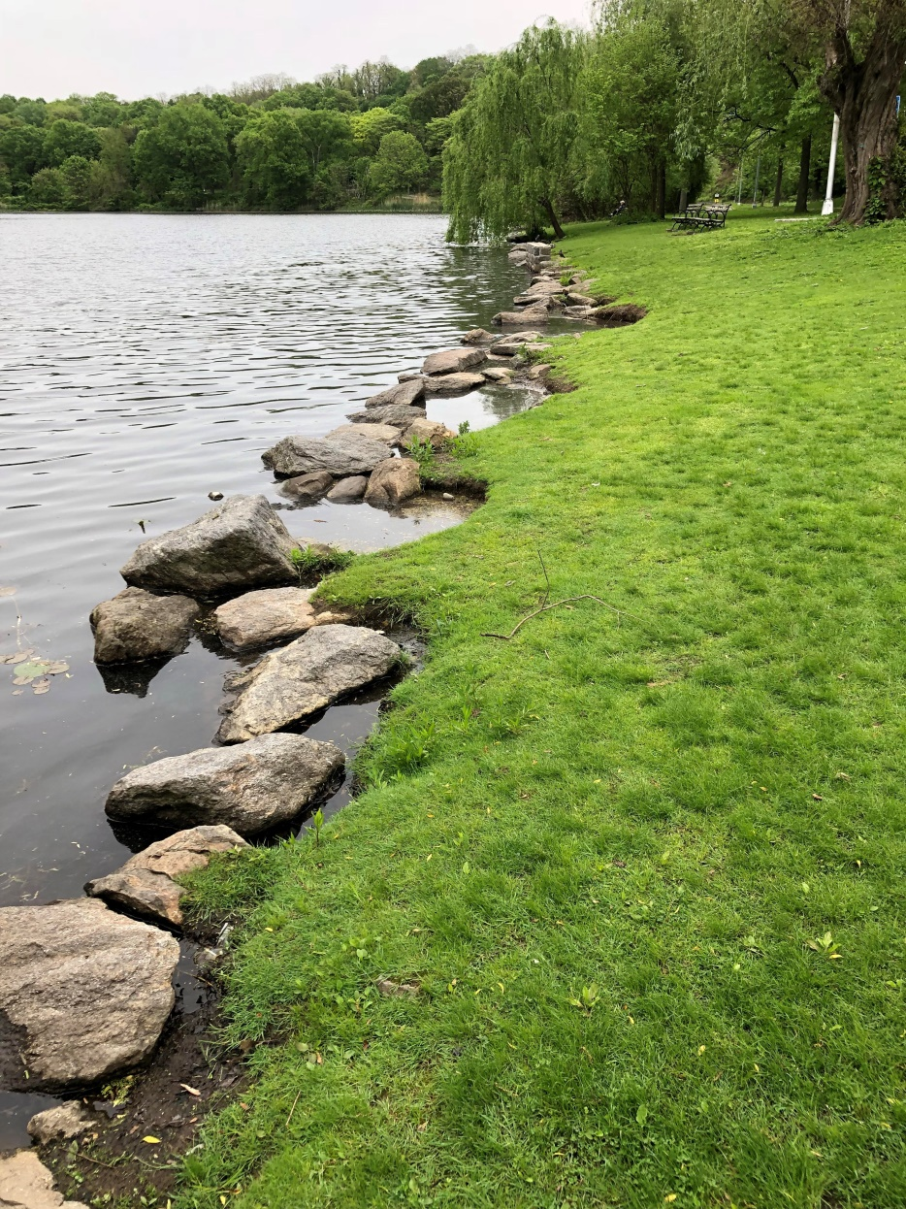
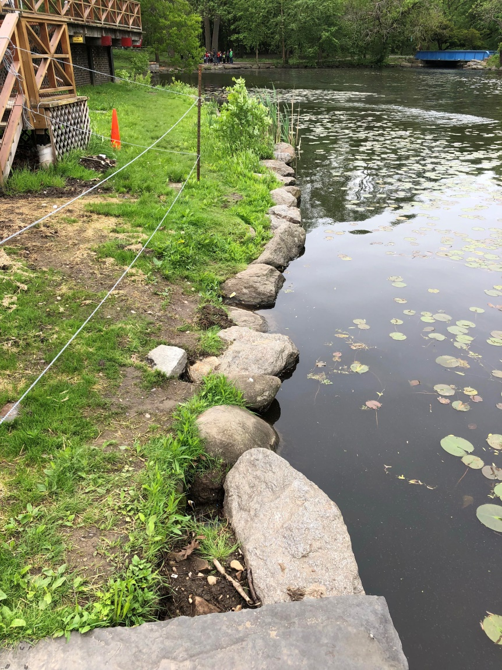

Slide 15
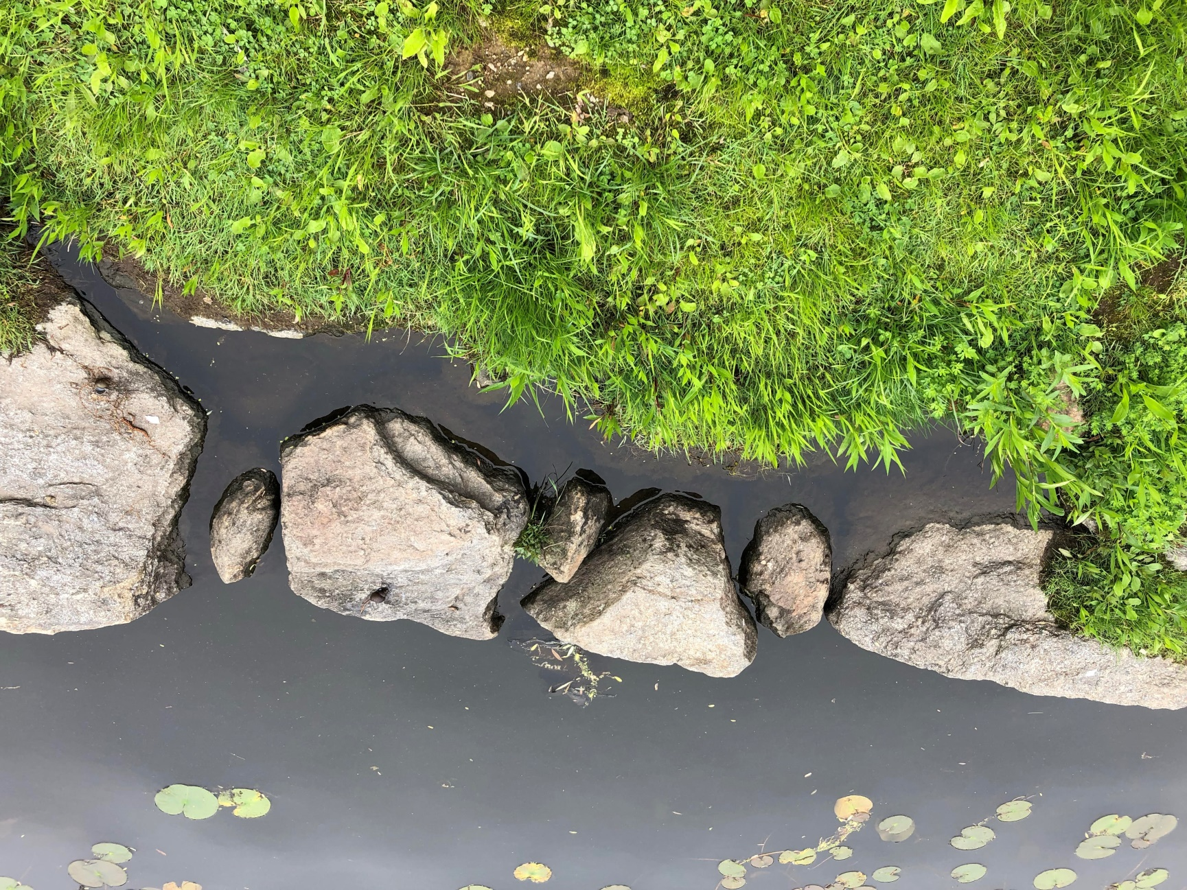

Slide 17
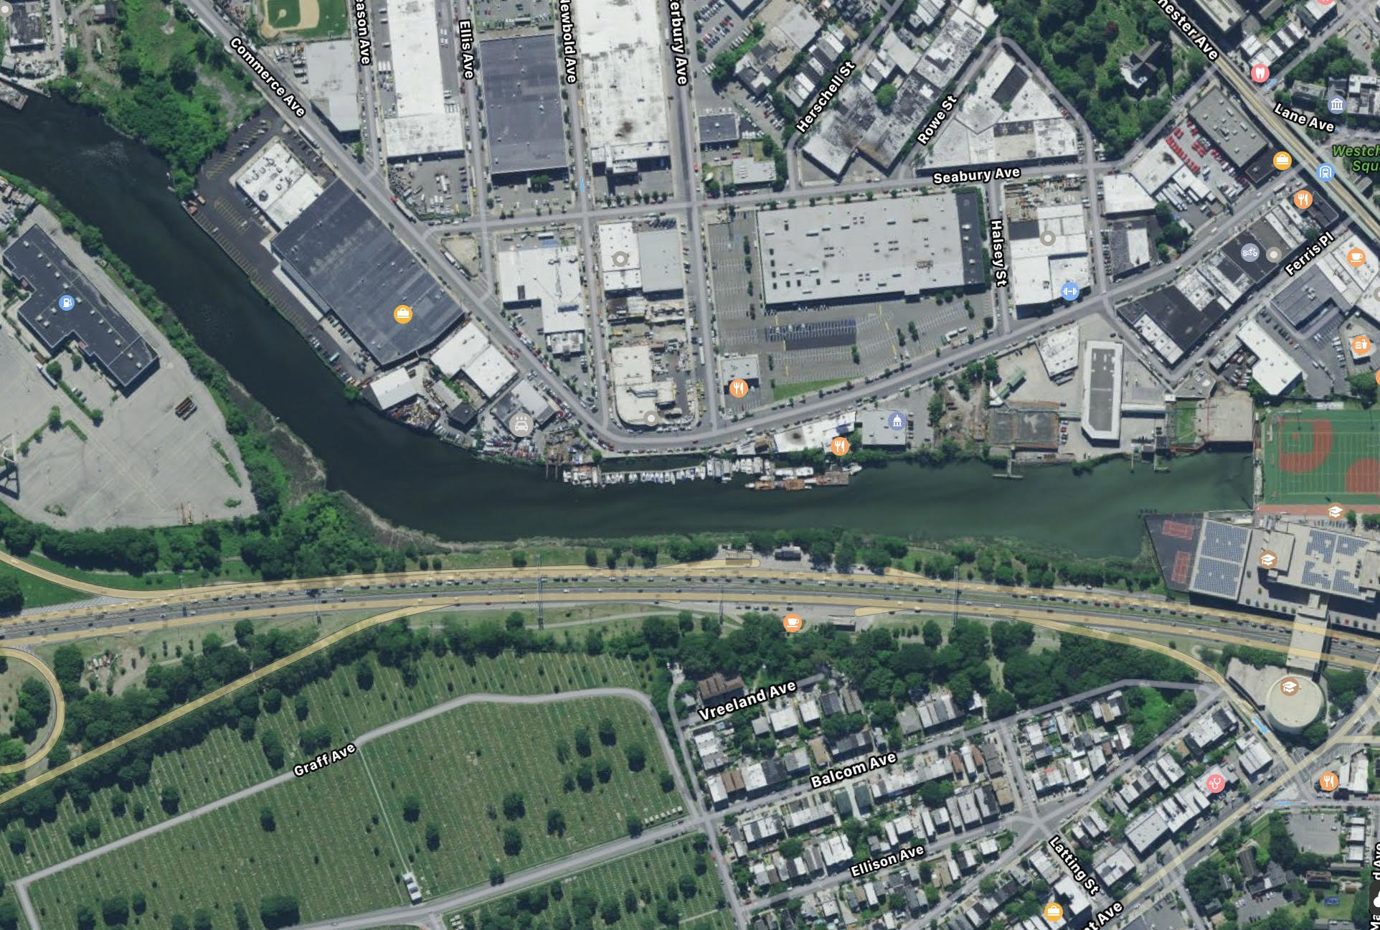
Site 2: Westchester Creek by Hutchinson River Parkway

Slide 18
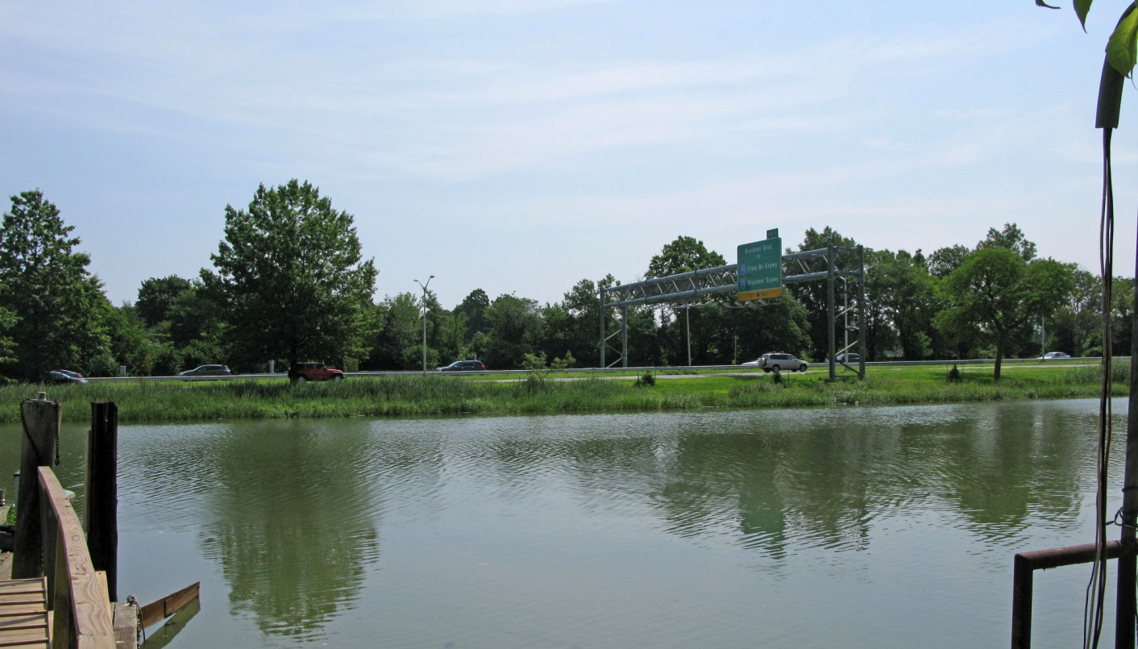

Slide 19
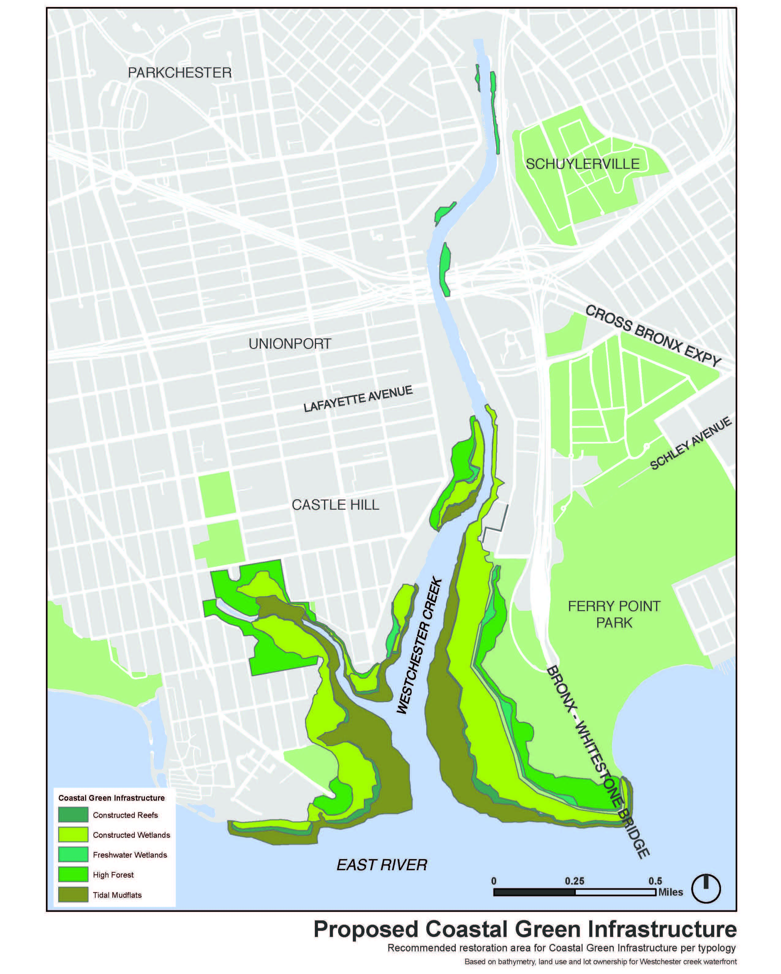
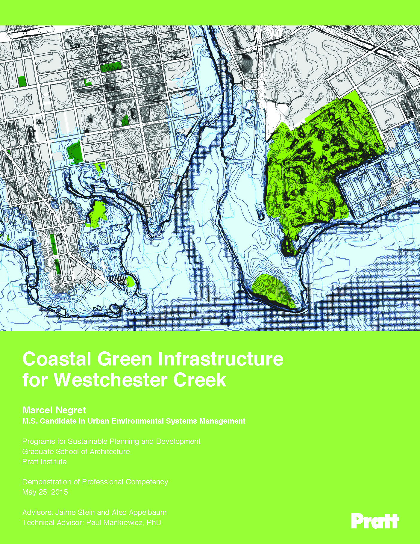

Slide 21
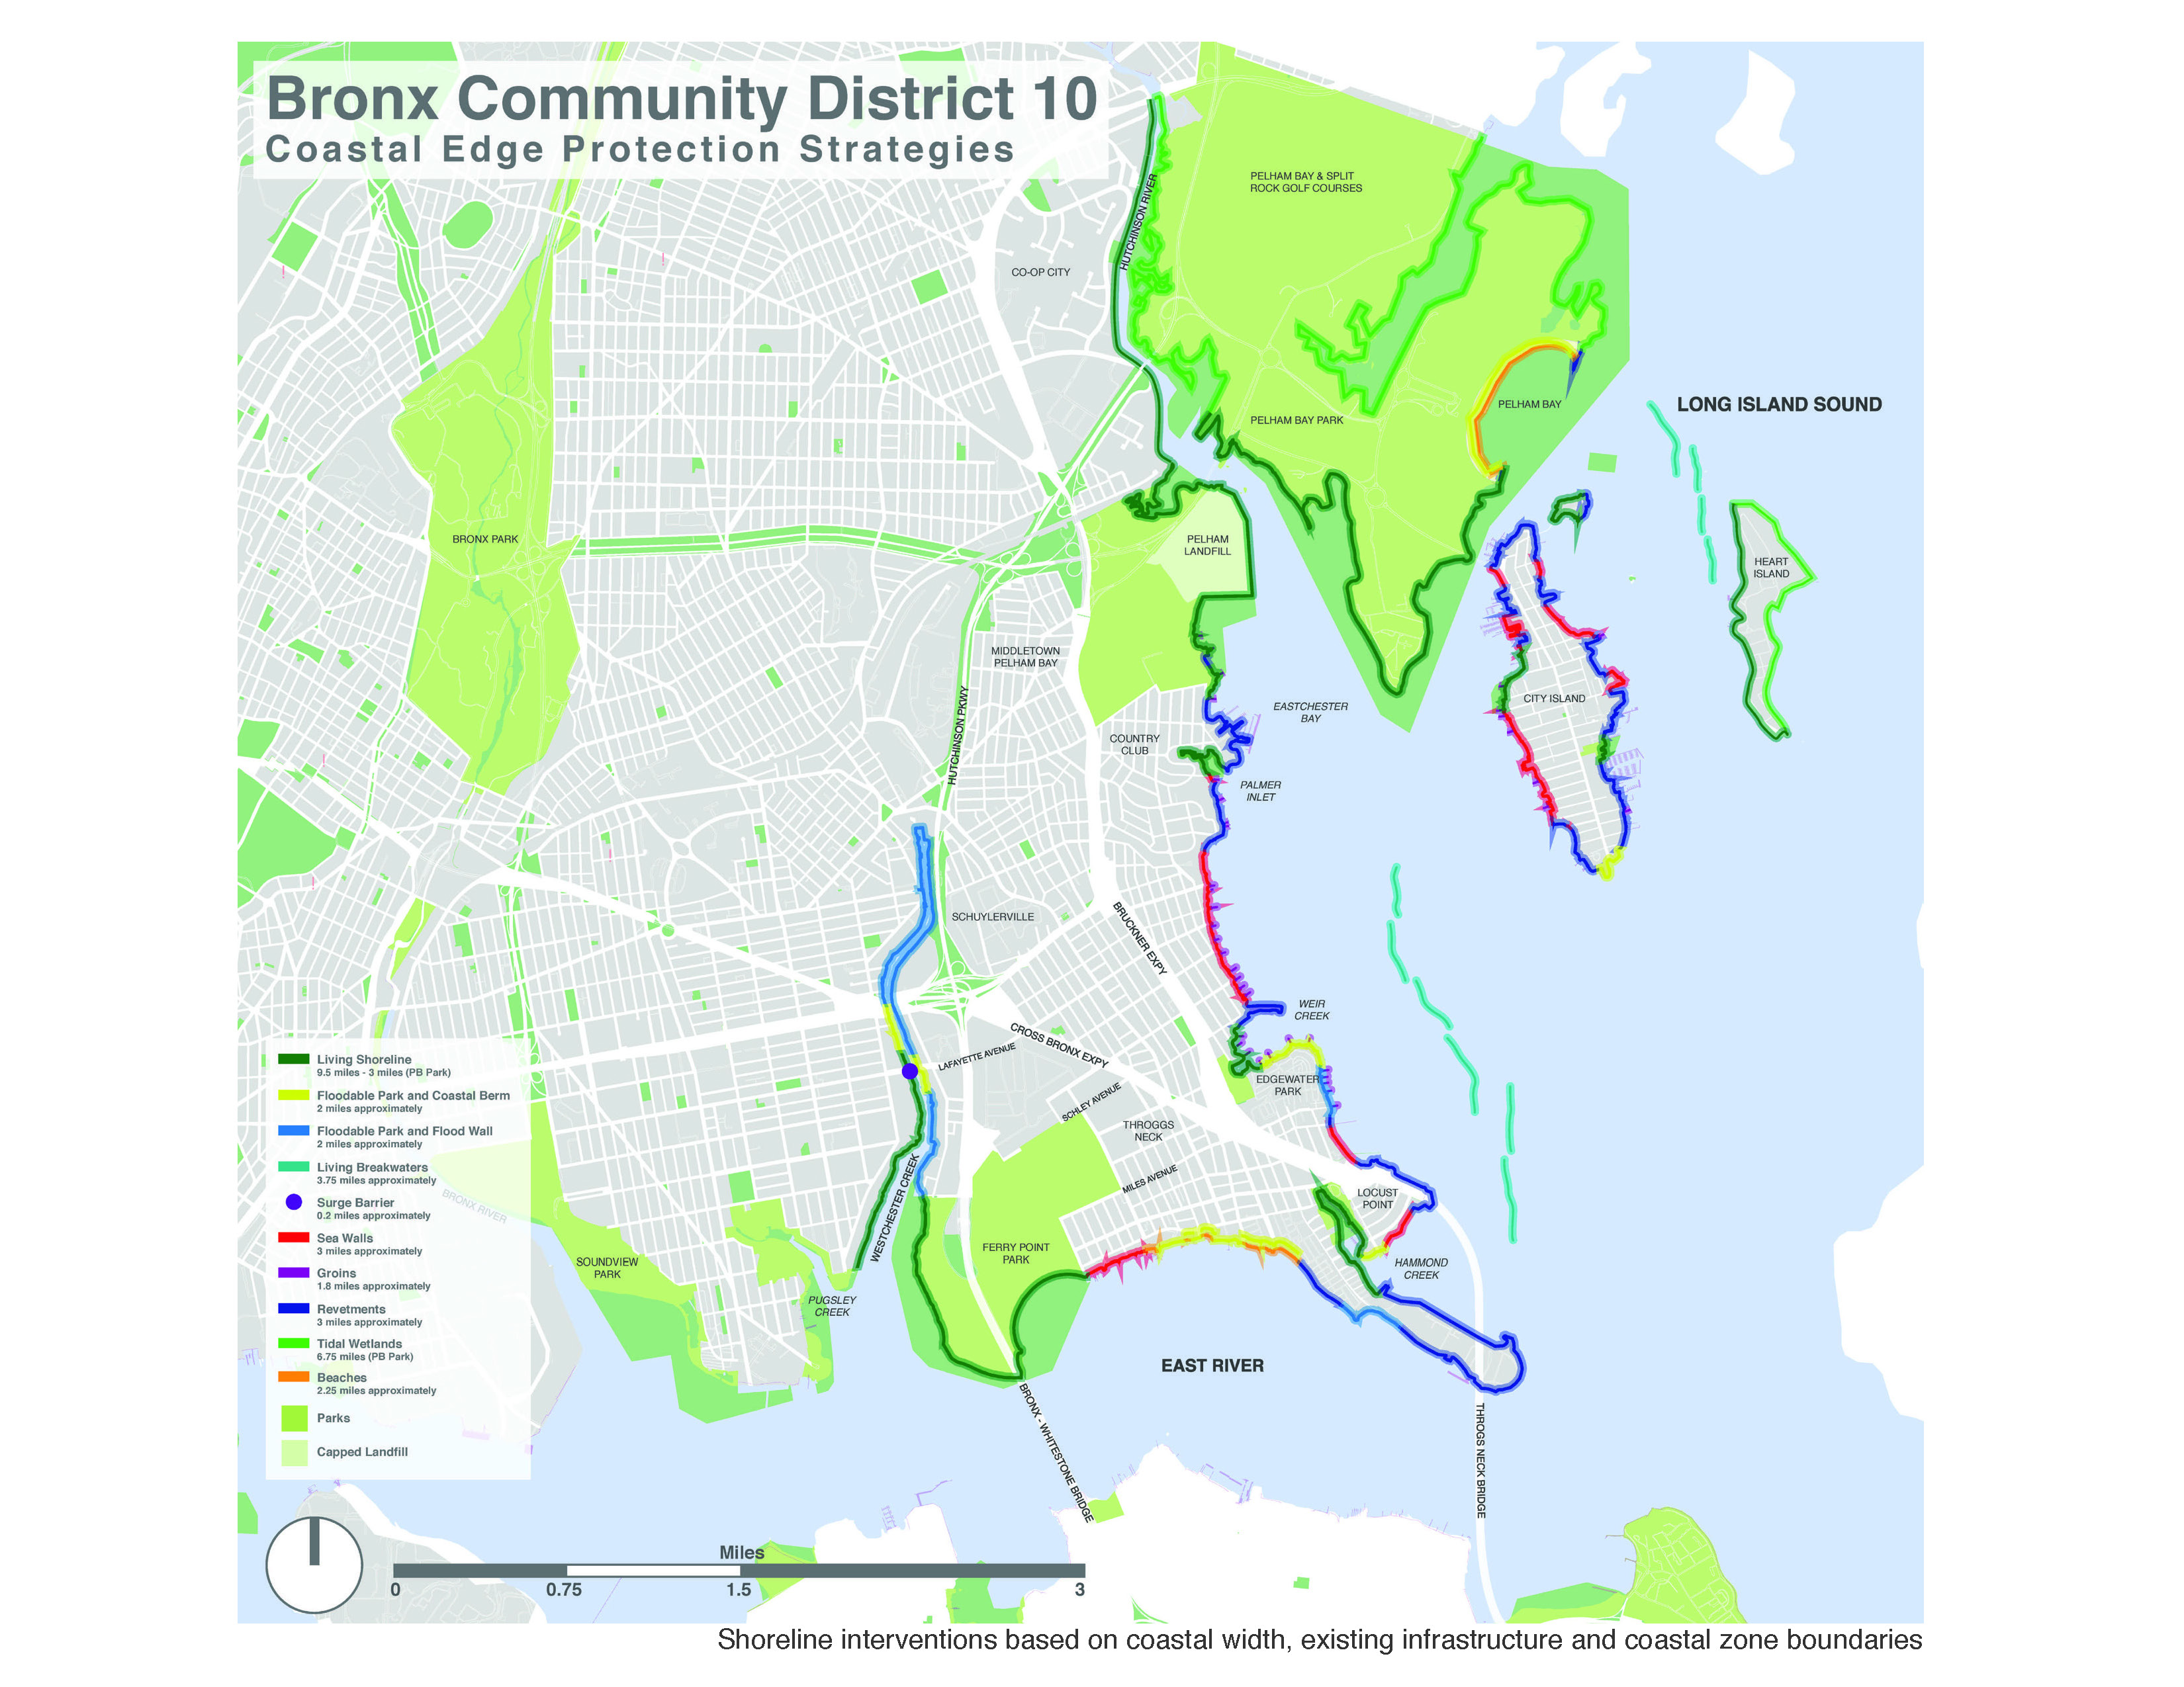

Slide 22
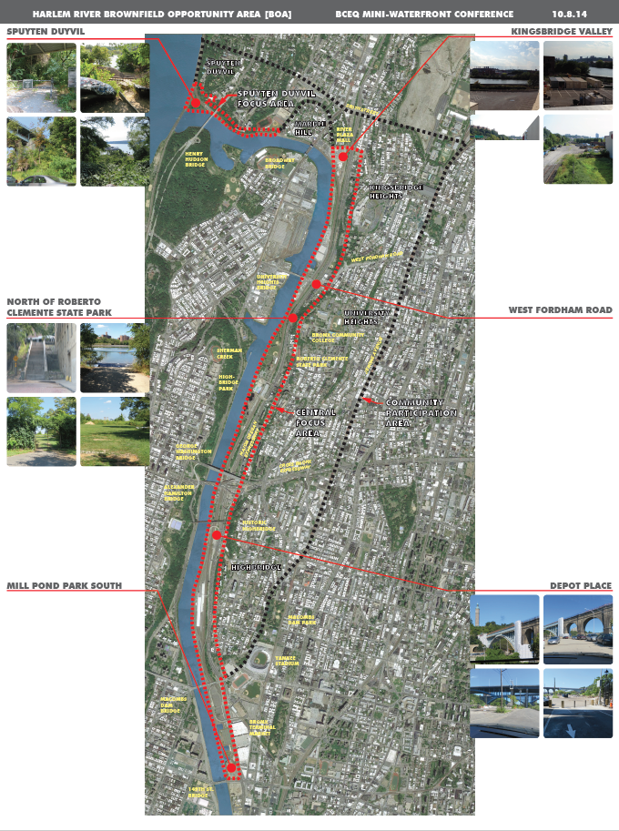

Slide 23
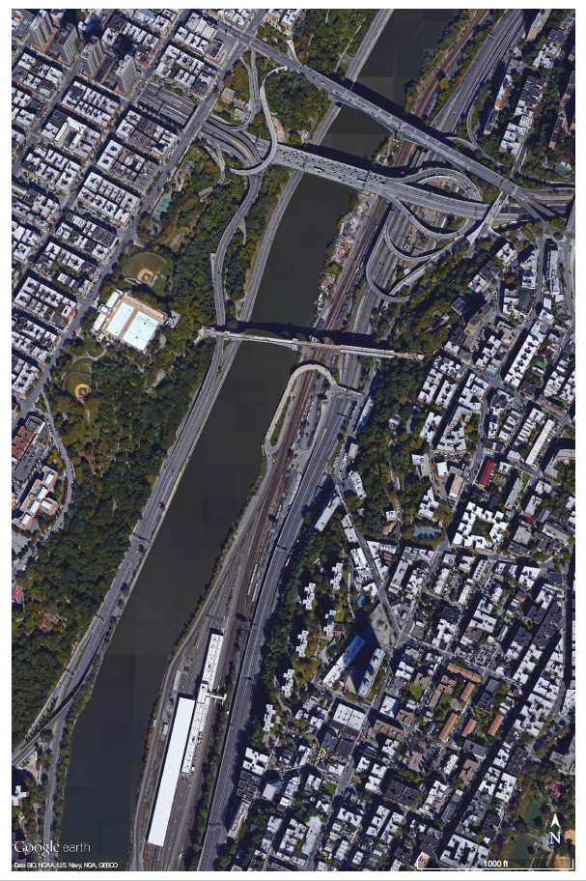
Site 3: Harlem River near Depot Place

Slide 24
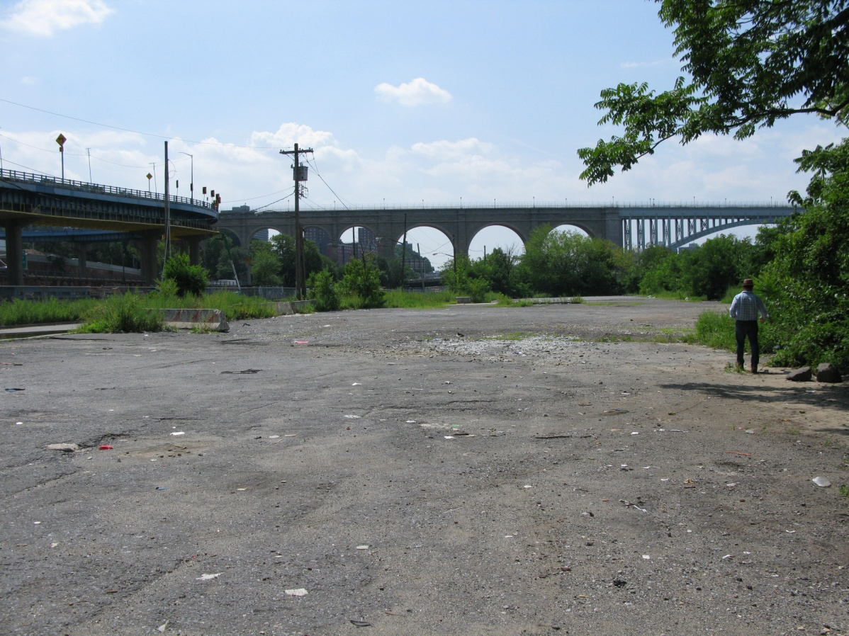
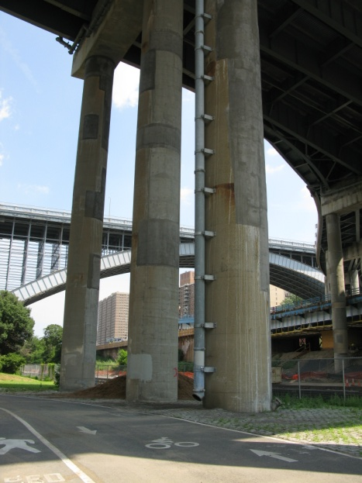
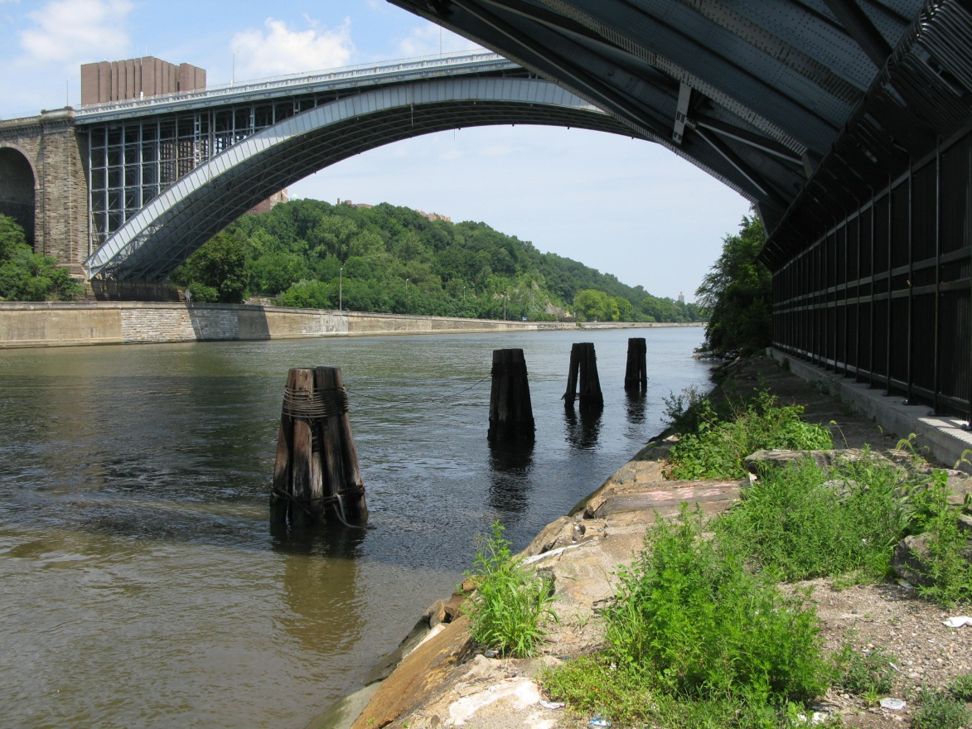
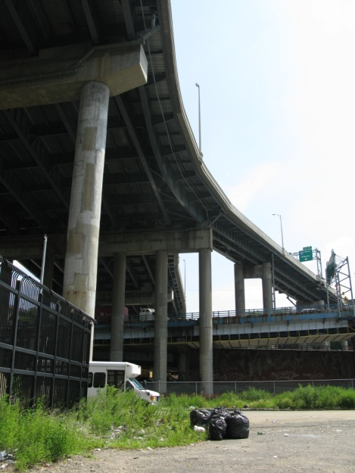

Slide 25
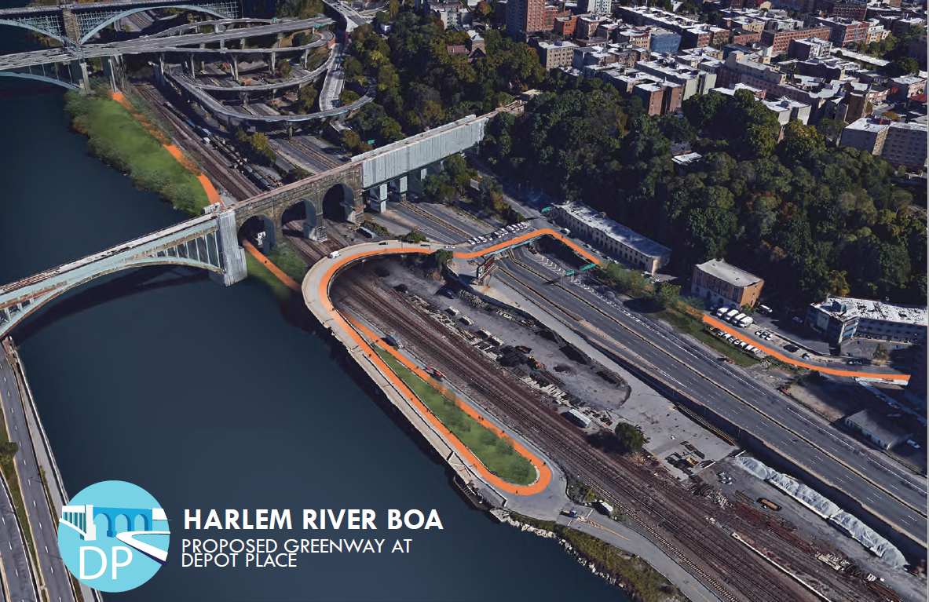

Slide 26
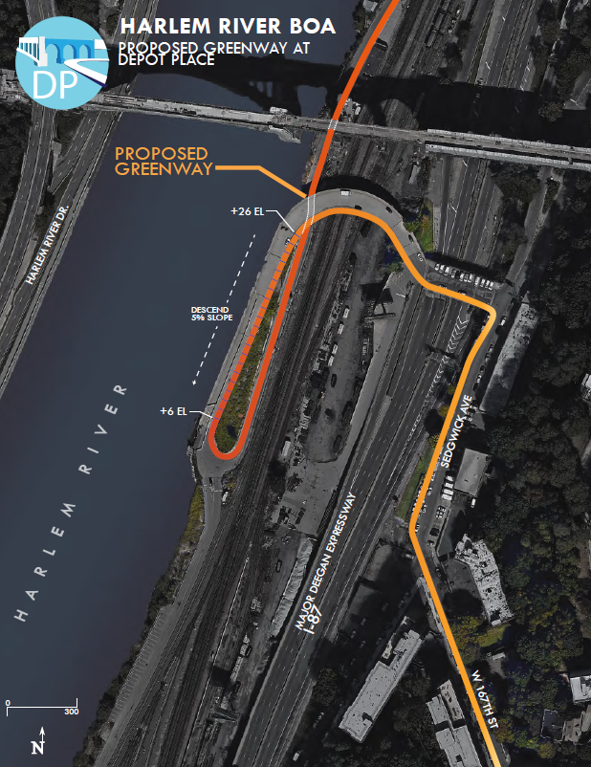

Slide 27
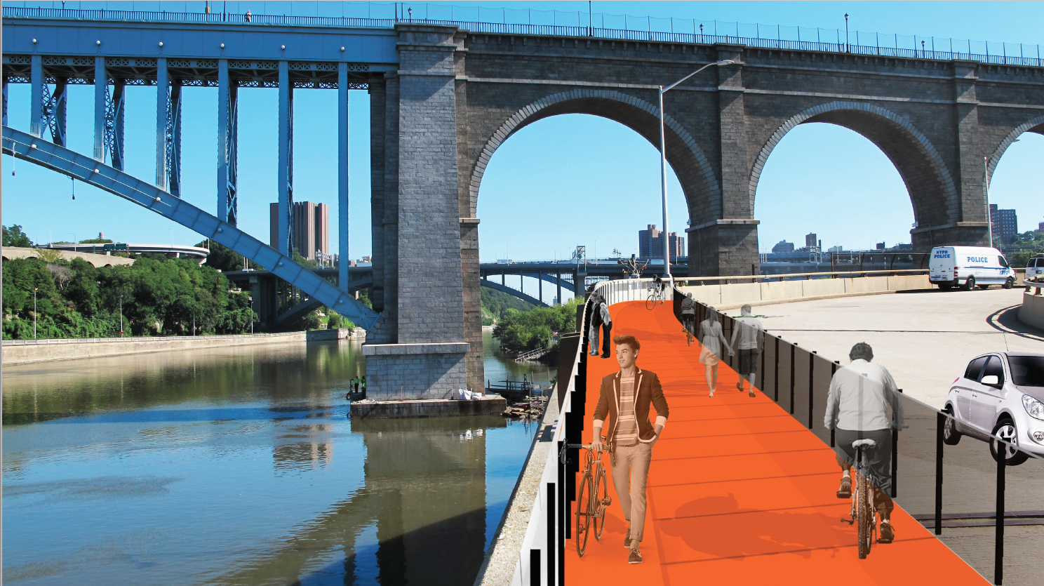

Slide 28
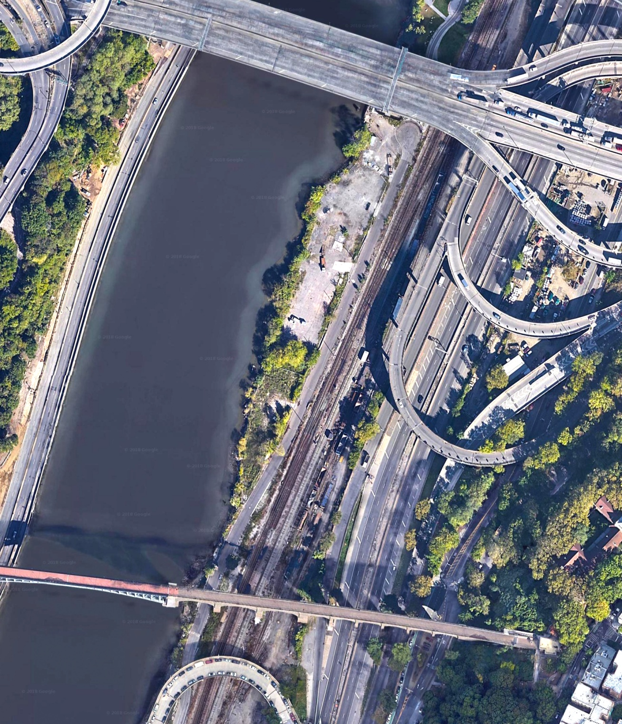

Slide 29
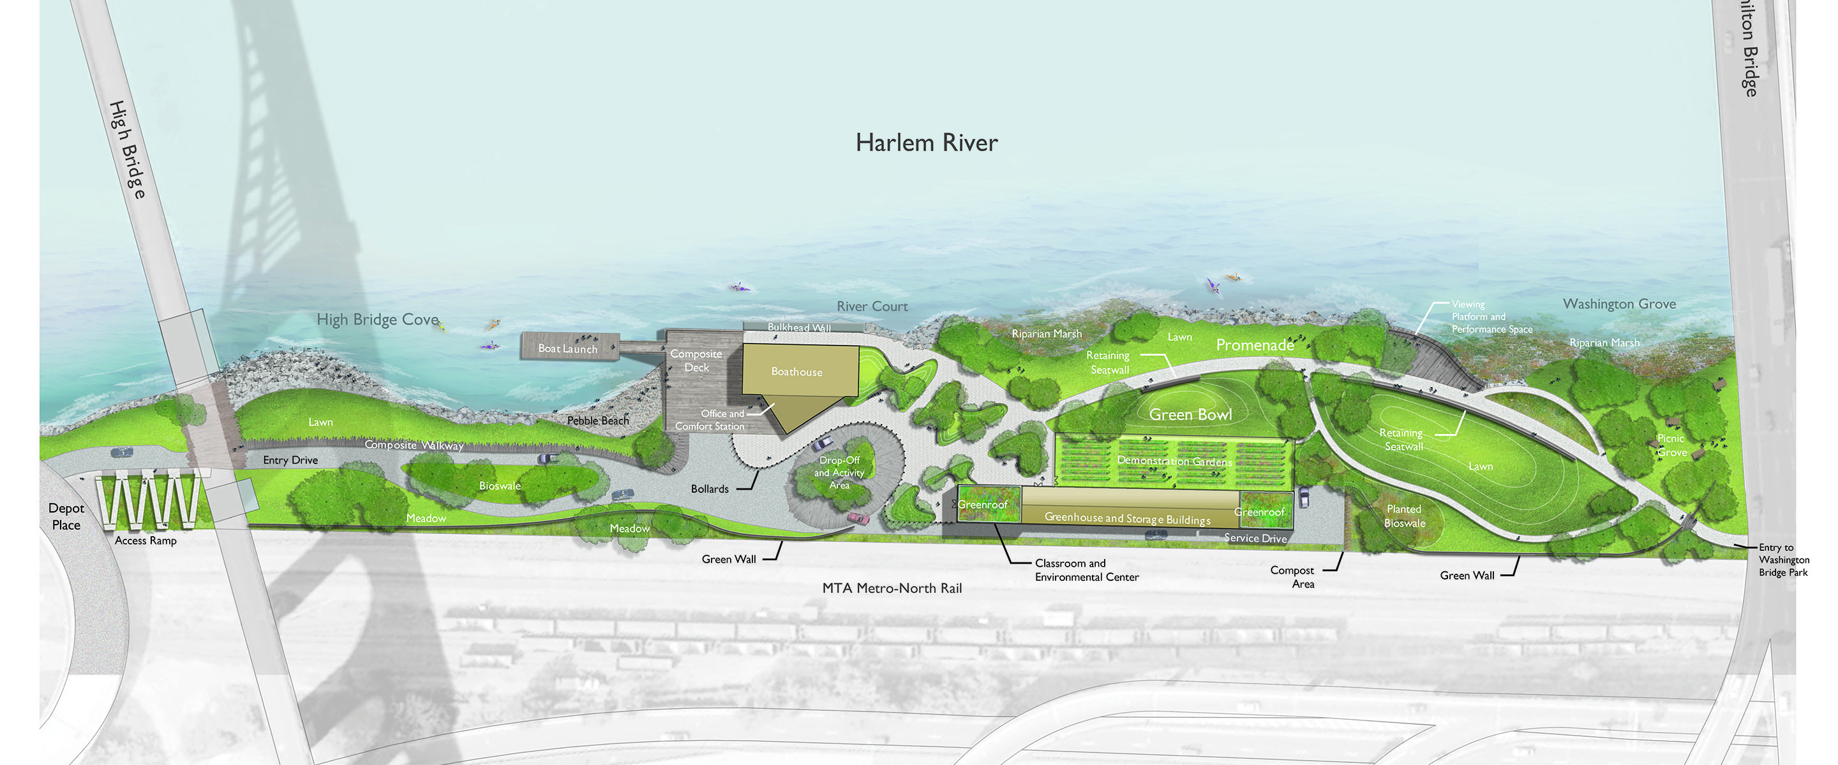

Slide 30
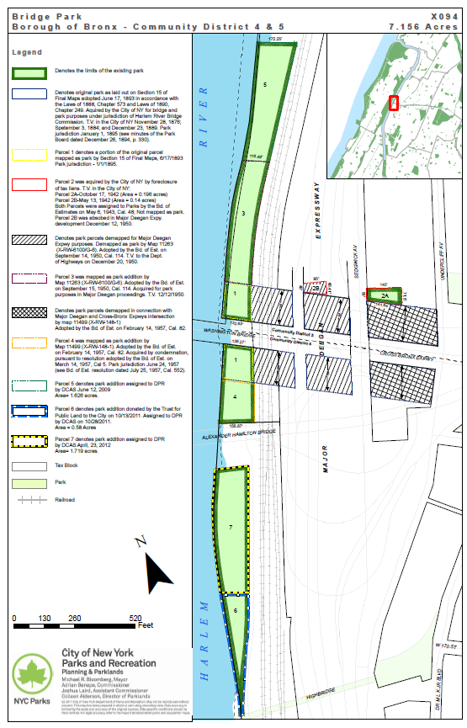

Slide 31
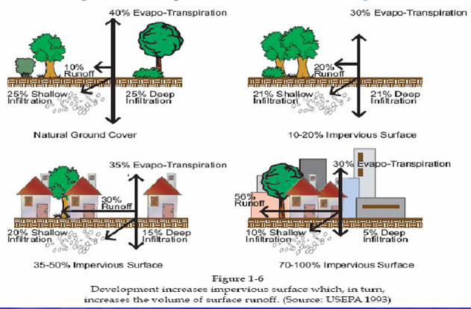

Slide 32
